Slide 2
Smart Intersection
Aspire Arduino Program

Slide 3
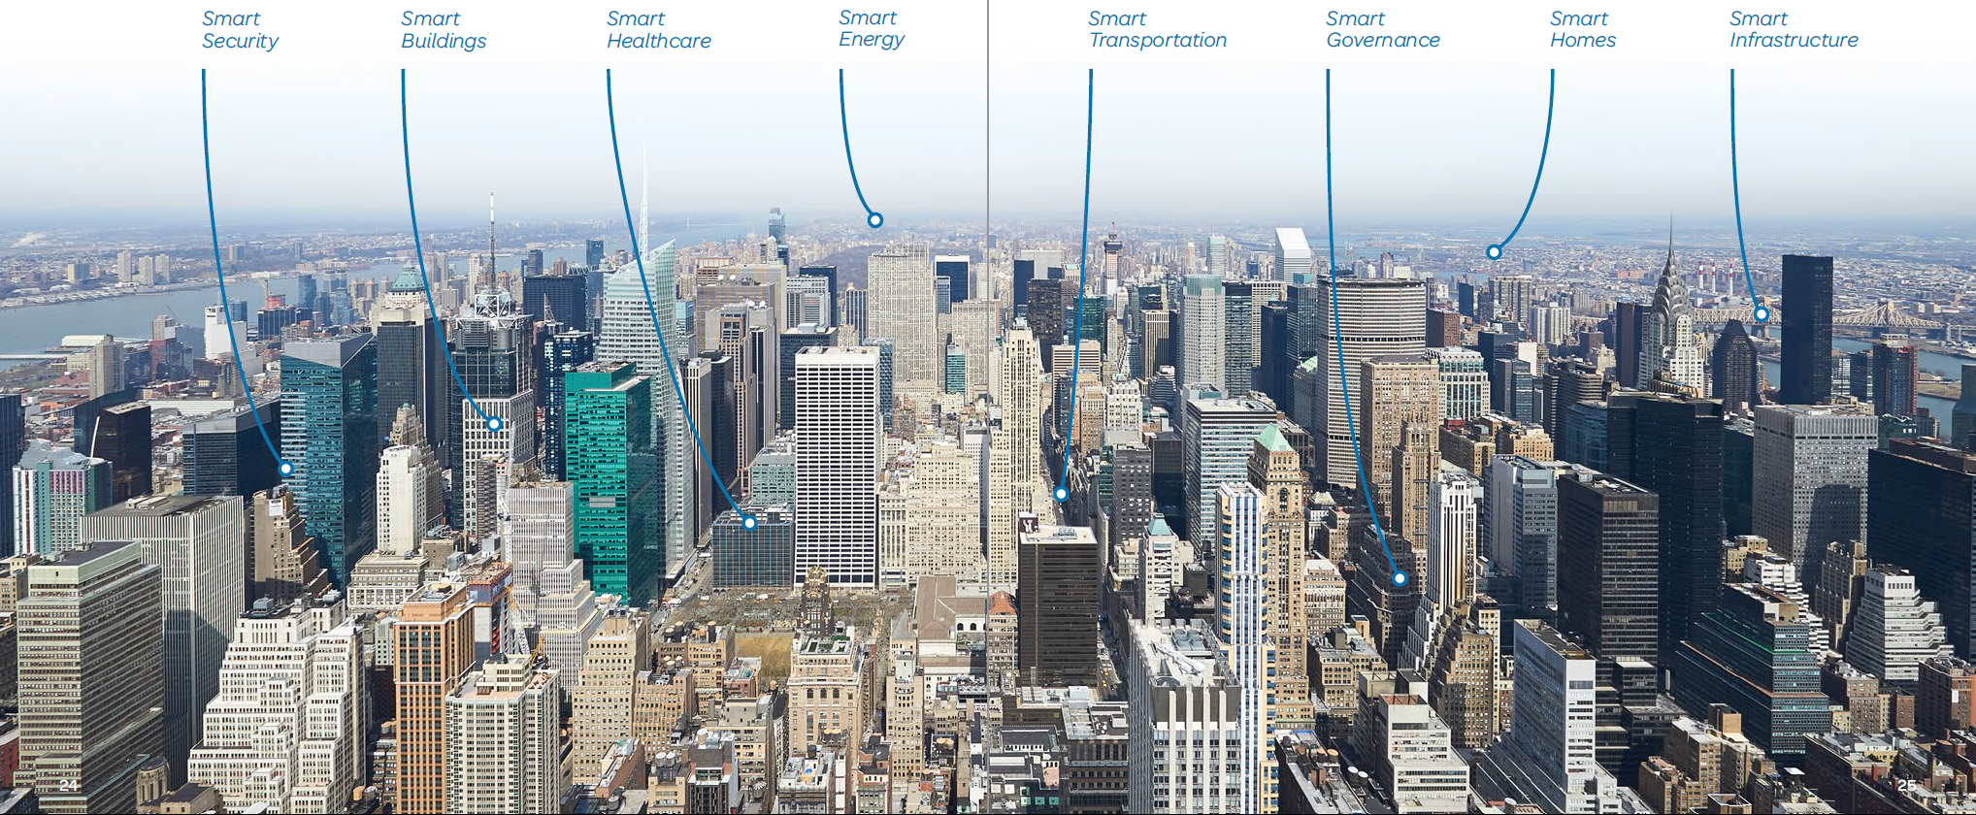
AT&T IOT & Smart City
Internet of Things – AT&T Smart Cities
The connected life – AT&T
Notes:
AT&T is a leader in IoT (Internet Of Things) connectivity and capabilities with the largest number of connected devices. AT&T also has strong relationships with applicable Smart Cities ecosystem providers such as devices, modules, equipment and electronics manufacturers. AT&T has strong, long-standing customer relationships with city governments around the world and has proven capabilities to design and manage large, complex solutions. "Welcome to the AT&T Business Solutions YouTube channel”
Smart Cities: https://www.youtube.com/watch?v=YYDqpgA6kTA
Mobilizing your world: https://www.youtube.com/watch?v=XOCUPCIWAek

Slide 4
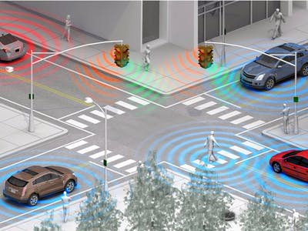
Smart Traffic Light

Slide 5
Scenario
Build a smart intersection that
Knows when it can let the orange car go
Lets the pedestrian know when it’s safe to cross

Slide 6
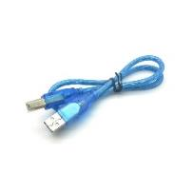
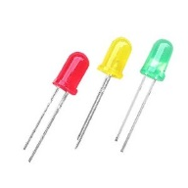
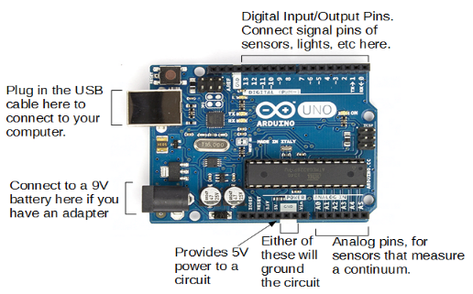
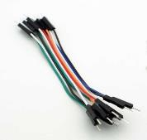
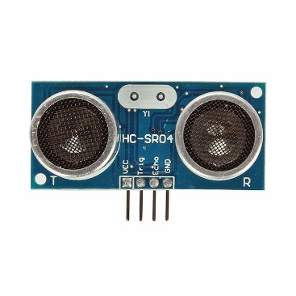
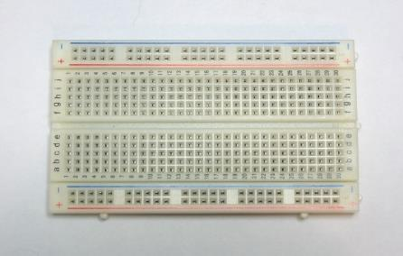
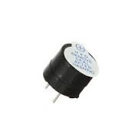
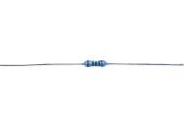
Materials
1 Arduino Uno
1 breadboard
1 Arduino USB cable
11 short wires, 2 long wires
2 100 Ohm resistor (brown-black-black-black-brown)
1 each green, yellow, red LED
1 HC-SR04 ultrasonic sensor
1 active buzzer

Slide 7
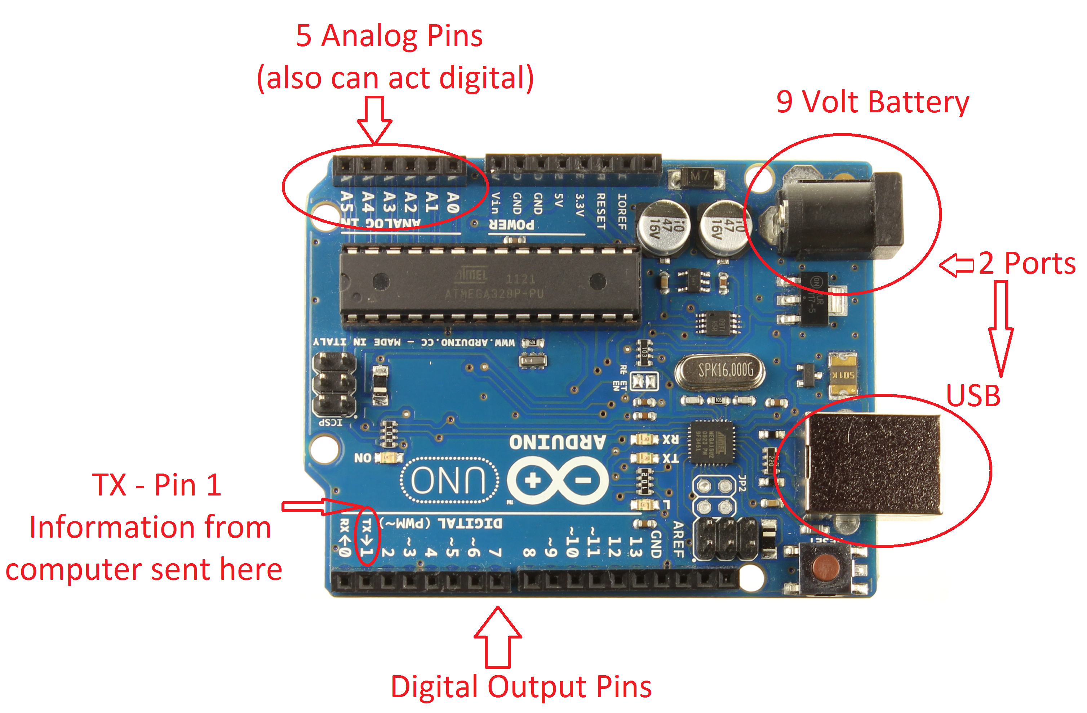
Arduino Intro
Arduino is an open-source electronics platform based on easy-to-use hardware and software.
It's intended for anyone making interactive projects.

Slide 8
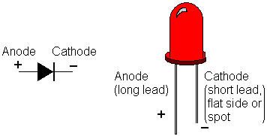
LED intro – Light Emitting Diode (LED)
Notes:
Explain LEDs – Light emitting diode, more commonly known as an LED, that is a two lead semiconductor source. It is a p-n junction diode, which emits light when activated. More simply, if you put a power source to the right end, it will light up.
Explain/Identify cathode and anode – The cathode is the negative end and the anode is the positive end. You can tell which is which by identifying which is the shorter end and which is the longer end. The anode is the longer end and the positive side. The cathode is the shorter end and the negative side. This will be important for making the traffic light, so remember this. Maybe, make a pneumonic.
Tell kids to take LEDs and make a wider V (suggestion)

Slide 9
LED Traffic Light
“Dumb” traffic light – just changes the lights on a schedule, doesn’t know or care if anyone needs to go
But, potential for making it smarter thanks to the Arduino

Slide 10
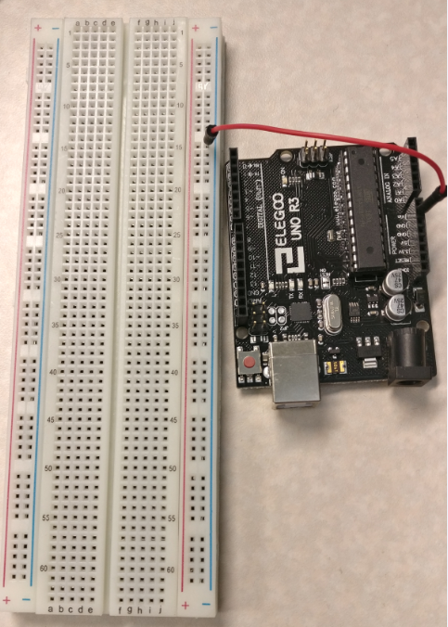
LED Traffic Light
Place short wire from Arduino GND (one near 5V) to (-) column nearest the Arduino in hole 15

Slide 11
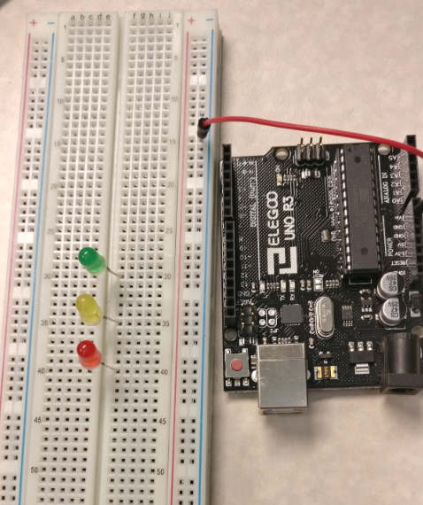
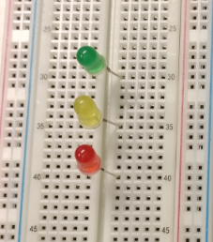
LED Traffic Light
Green LED - short leg in e30, long leg in f30
Yellow LED - short leg in e35, long leg in f35
Red LED - short leg in e40, long leg in f40

Slide 12
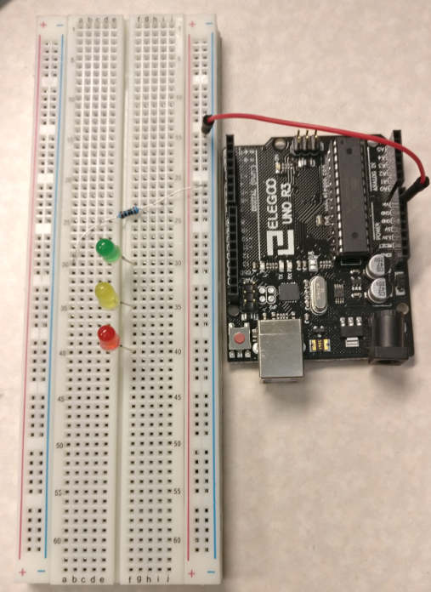
LED Traffic Light
Place one 100 ohm resistor (-)20 to a30

Slide 13
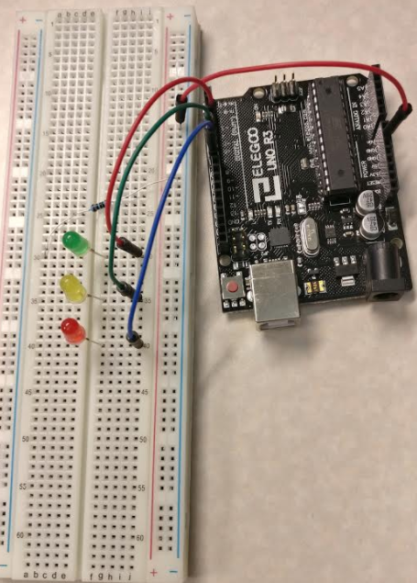
LED Traffic Light
Use short wire to link Arduino digital 5 to j30 (green long leg)
Use short wire to link Arduino digital 6 to j35 (yellow long)
Use short wire to link Arduino digital 7 to j40 (red long)

Slide 14
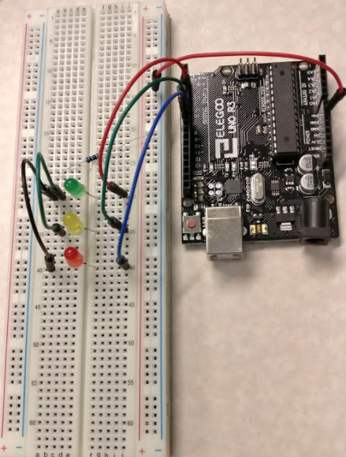
LED Traffic Light
Wire between c30 and c35
Wire between b30 and b40

Slide 15
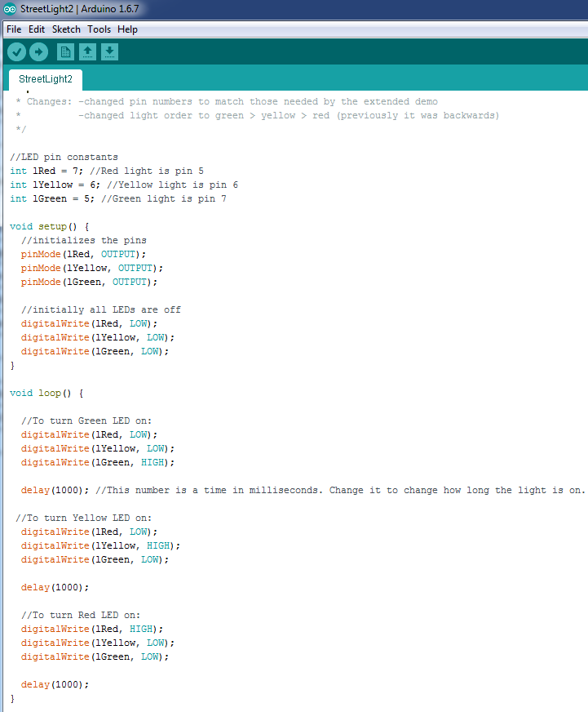
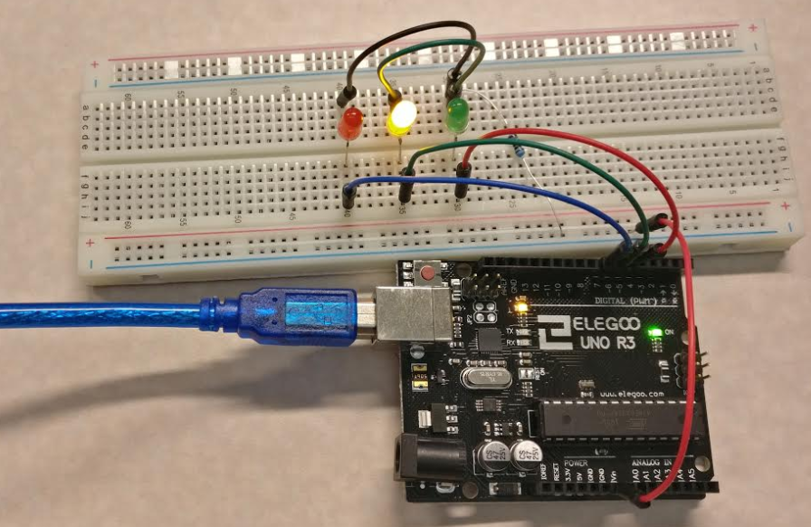
LED Traffic Light
Plug the Arduino into the laptop with the Arduino USB cable
Load “Streetlight2.ino”
Modify code to change light interval

Slide 16
LED Traffic Light Troubleshooting
LEDs not lighting up?
Doublecheck the wiring
Doublecheck the LEDs are facing the correct direction

Slide 17
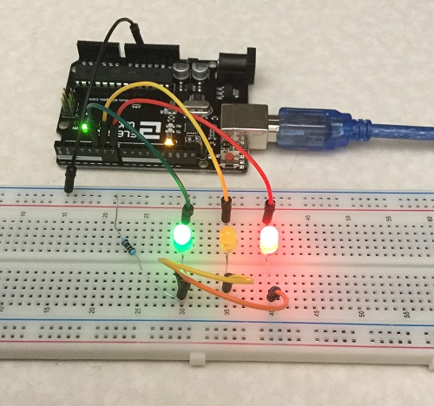
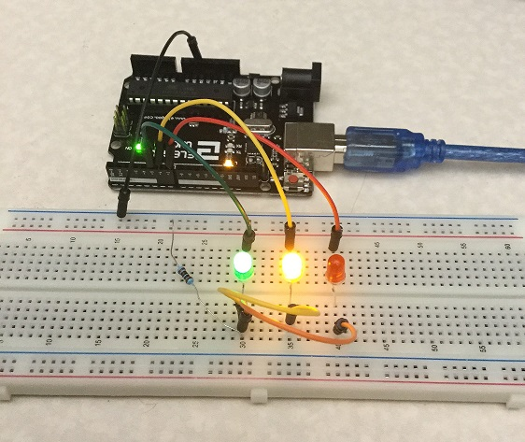


LED Traffic Light Troubleshooting
Two LEDs lighting up simultaneously even though the code has them each go in sequential order?
One LED might be reversed, creating a loop between those two. Doublecheck the direction of the two in question.
GND
Arduino
Instead of power flowing from the Arduino, through the single LED (here, red), and back to the Arduino via ground, it returns via the reversed green LED.
In this case, the green LED is reversed with yellow and red correct, so it lights up with both yellow and red.

Slide 18
Ultrasonic Sensor
Make the traffic light smart by giving it a way to tell if any cars are coming along one branch of the intersection
Sensor can tell if something is there

Slide 19
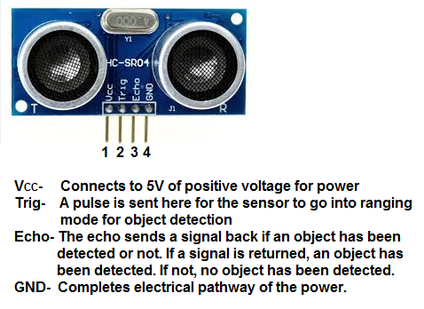
Ultrasonic Distance Finder Intro
Sends out ultrasonic sound pulses and listens to time how long it takes for them to return.
Distance = (time of flight/2)(speed of sound)

Slide 20
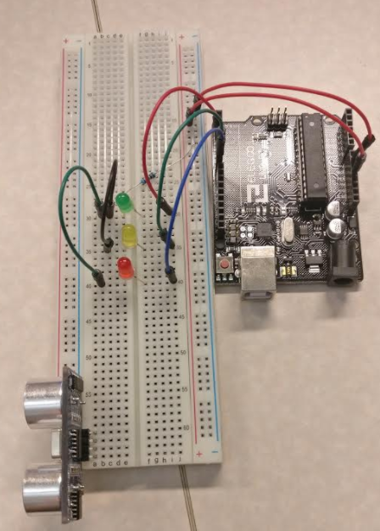
Ultrasonic Sensor
Place a short wire in Arduino 5V to closer (+) column
Plug sensor in a60-64 with VCC in a60
Notes:
Keep existing setup

Slide 21
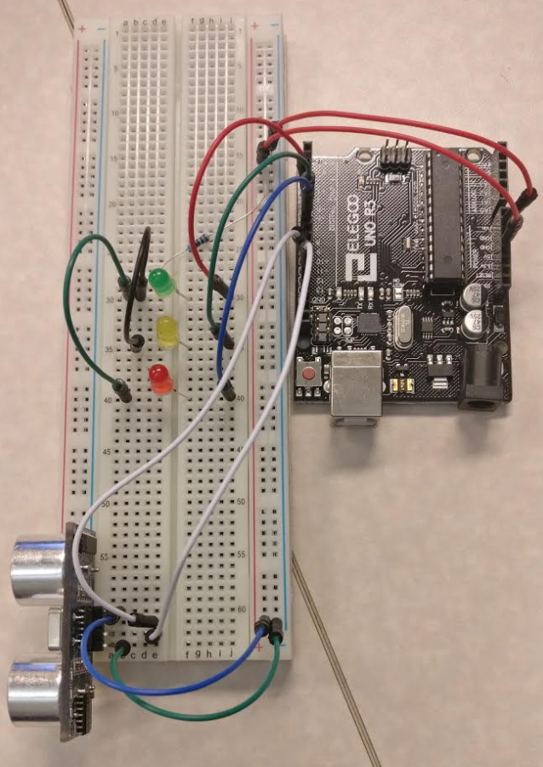
Ultrasonic Sensor
Connect sensor GND to (-) column
Connect sensor VCC to (+) column
Arduino digital 11 to sensor TRIG
Arduino digital 12 to sensor ECHO

Slide 22
Ultrasonic Sensor
Plug the Arduino back in with the USB cable
Upload “smartTrafficLight.ino”

Slide 23
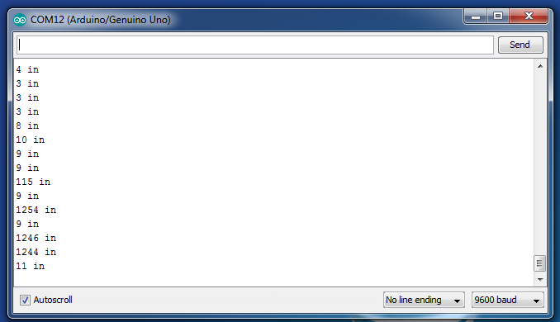
Ultrasonic Troubleshooting
To check that you’re getting expected distance values, you can use the Serial Monitor.
Uncomment all of the Serial lines of code (one in setup and two in loop after the distance calculation), save, and re-upload to the Arduino
Go to the Tools tab of the IDE and click on Serial Monitor while the Arduino is running
If you’re getting any 1000+ readings, that’s probably just something weird happening with the sound reflection so just ignore it

Slide 24
Active Buzzer
Many intersections play a sound so blind pedestrians can tell when they can safely cross
Add a buzzer to the circuit to simulate this

Slide 25
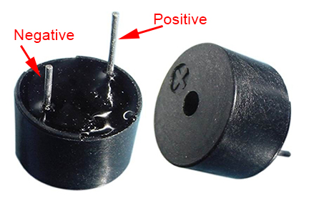
Active Buzzer Intro
When a DC voltage is applied, an oscillator is activated
An oscillator is a piece of material that vibrates when current flows through it
These vibrations make noise, just like your vocal chords

Slide 26
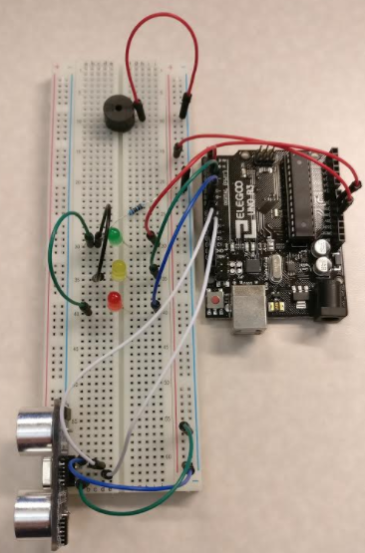
Active Buzzer
Place Buzzer (+) in e10, buzzer (-) in f10
Wire buzzer (-) to (-) rail

Slide 27
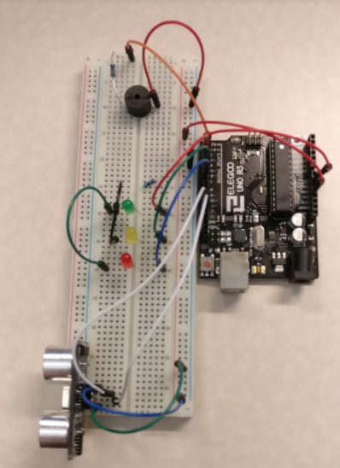
Active Buzzer
100 Ohm resistor buzzer + to a1
Wire connecting e1 to Arduino digital 2 (note: digital 2 is a PWM (pulse wavelength modulation), you can tell because it has a ~ by the number; the buzzer needs to be in a PWM pin so if 2 doesn’t work, try another port with the ~)
Uncomment “play buzzer” code block, save, re-upload

Slide 28
Discussion Questions
Do you see any problems in how the traffic light responds to the sensor input? How could you improve it?
Can you think of any improvements for the crossing buzzer?
What else might you add or change to make this smart intersection smarter?

